Slide 1
UI designer
Hao Zhong
Shanghai Jiao Tong University

Slide 2
Last class
Scope
Project manager
Responsibility
Cost estimation
Planning
Risk
CVS
Issue tracker
Cost
Time

Slide 3
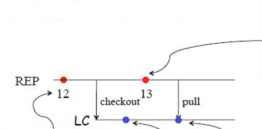
Concurrent Development

Slide 4
Merge Conflict

Slide 5
Merge is textual
Code may not work after merge
Developer A makes the change:
f (int x, int y) -> f(int x, int y, int z)
Developer B makes the change:
insert f(a, b)
Merge problems
Code will not compile
It is lucky that it does not compile!
Communication: notify the people who may be affected
Auto test suite and Regression testing!!
M. Tufano, F. Palomba, G. Bavota, M. Di Penta, R. Oliveto, A. De Lucia,
and D. Poshyvanyk. There and back again: Can you compile that
snapshot? Journal of Software: Evolution and Process, 2016.

Slide 6
Branch
Users report bugs for a released version
Bug fixes are applied on this specific version
Programmers are developing to next version (branch)
Need to merge before the next release

Slide 7
Other reasons for branches?
Temporary versions
Implement new features (tentative)
Isolate changes to have a stable trunk
Eventually merge back to the trunk
Snapshot for testing
Development continues
Fixes eventually merge back to the trunk
Separate branch for different release
Different OS, …

Slide 8
Software process models
Requirements
engineering
Design
Implementation
Integration
The waterfall model

Slide 9
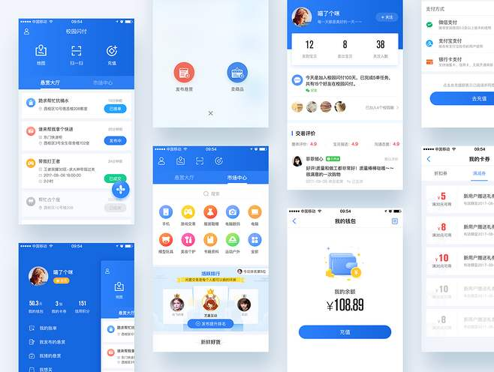

Role
User interface design (UI) or user interface engineering is the design of user interfaces for machines and software, such as computers, home appliances, mobile devices, and other electronic devices, with the focus on maximizing usability and the user experience.

Slide 10
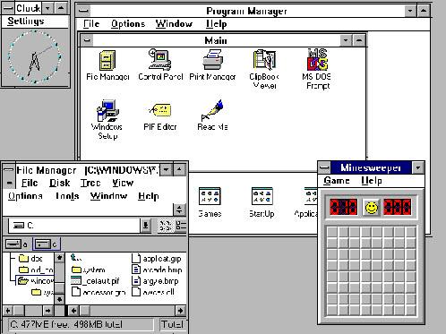
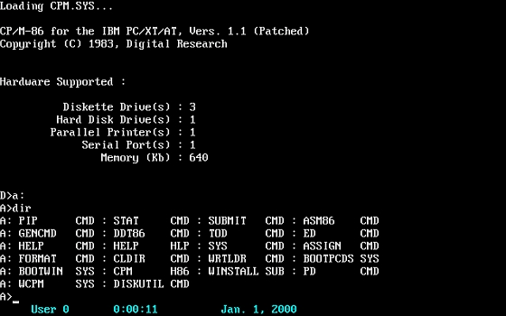
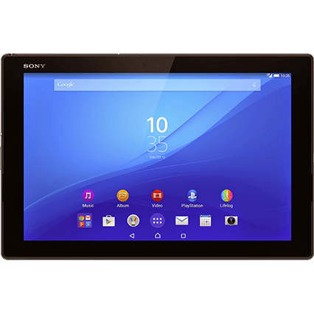
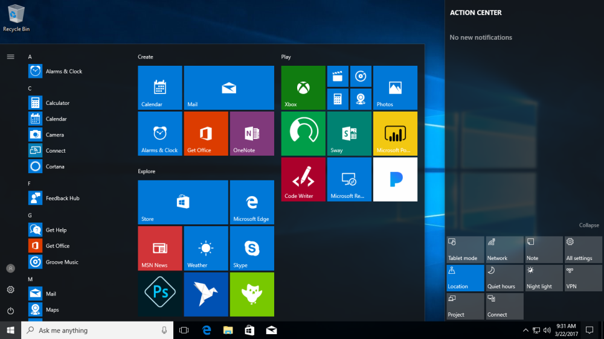
The history of UI

Slide 11




Why it matter
System users often judge a system by its interface rather than its functionality
A poorly designed interface can cause a user to make catastrophic errors
Poor user interface design is the reason why so many software systems are never used

Slide 12
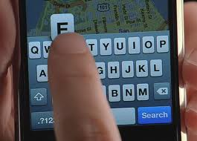
Human-Computer Interaction
Two problems must be addressed in interactive systems design
How should information from the user be provided to the computer system?
How should information from the computer system be presented to the user?
User interaction and information presentation may be integrated through a coherent framework such as a user interface metaphor (隐喻)

Slide 13
Software Process Models
Requirements
engineering
Design + build
prototype
Validate
prototype
Formalize
requirements
Design and
implementation
Integration
UTSA CS5103
The prototype model

Slide 14
User interface design process

Slide 15
Prototyping
Paper prototyping (static)
Show users various UI menus and ask them to group the ones that are similar, to see what UI tasks are seen as being related by users.
Code prototyping (dynamic)
Tools

Slide 16
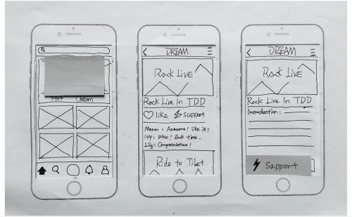
Creating a paper prototype
Your requirements and designs?
Identify the screens in your UI
consider use cases, inputs and outputs to user
Think about how to get from one screen to next this will help choose between tabs, dialogs, etc.
Drawing the background

Slide 17
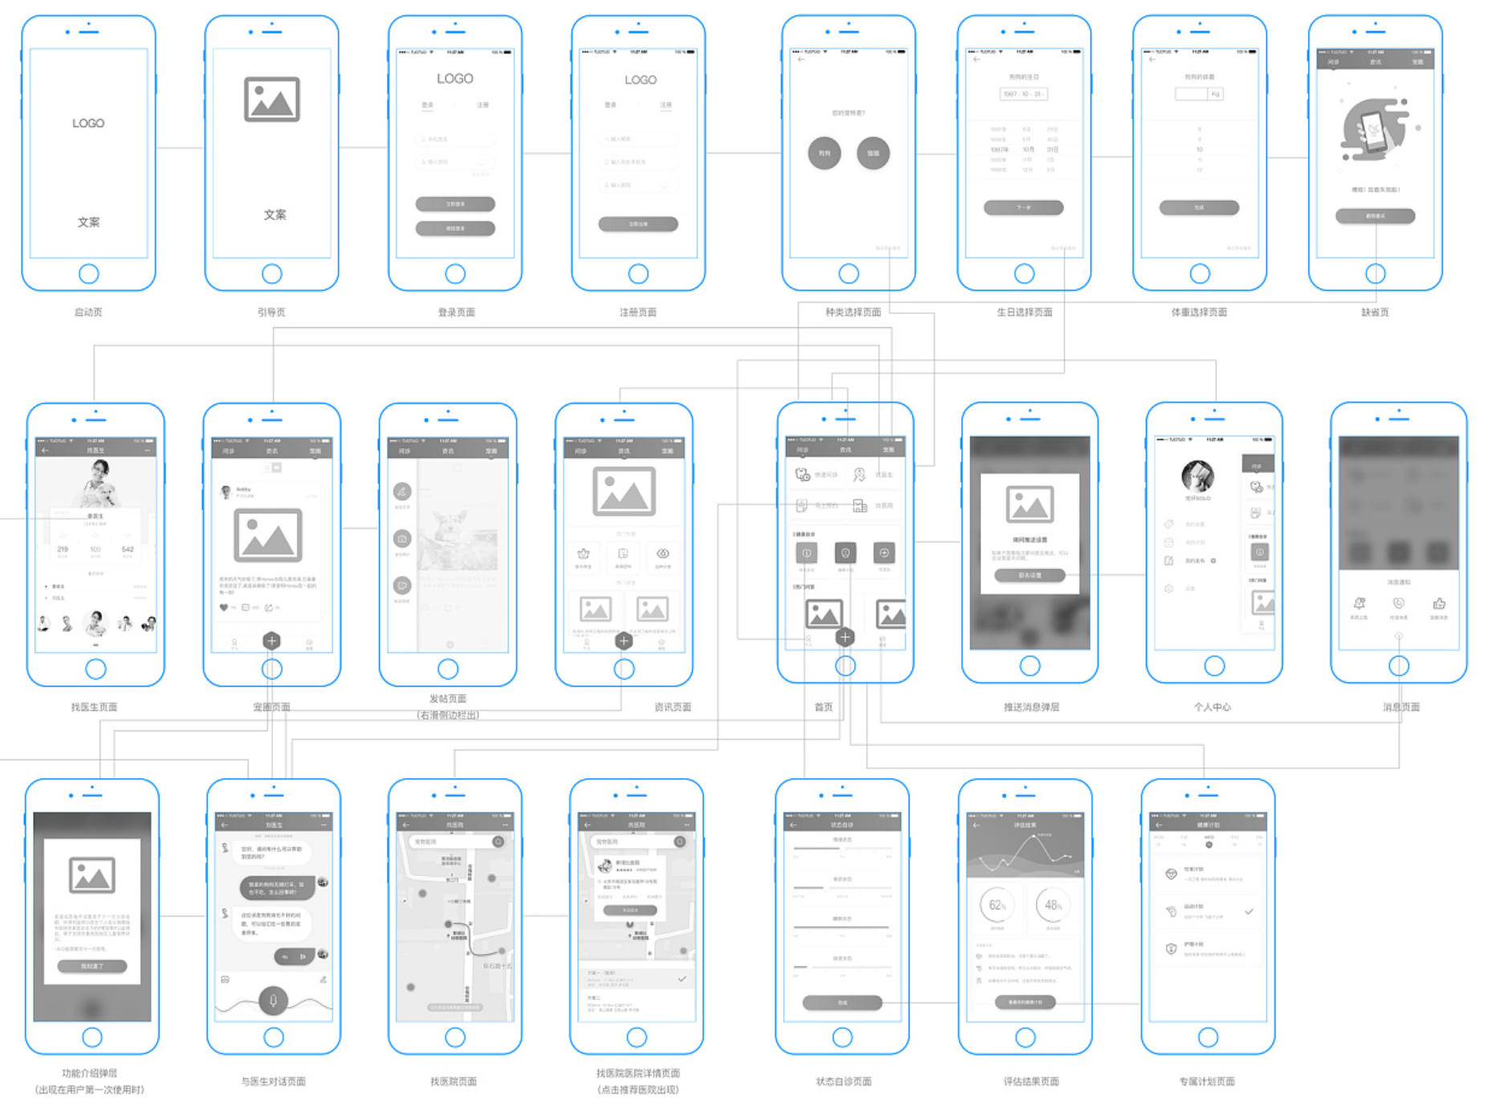
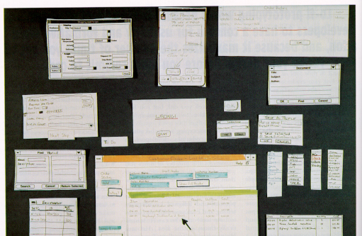
Representing a changing UI

Slide 18
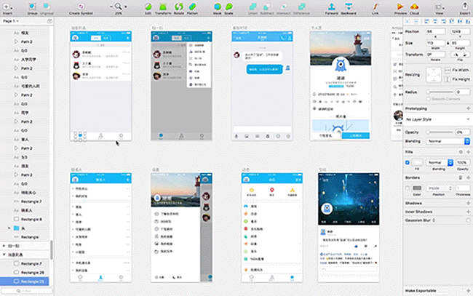
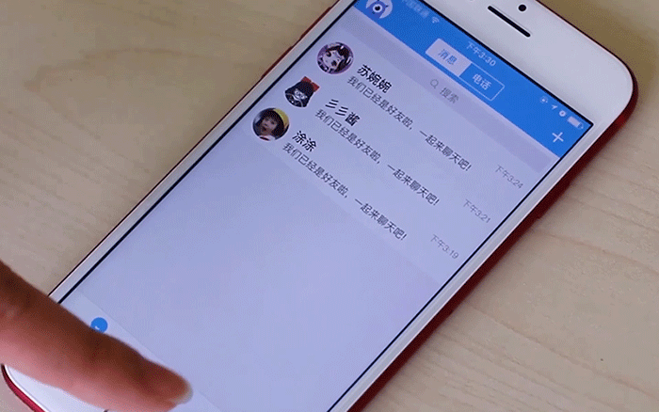

Code prototype
UI builders (Visual Studio, ...)
Draw a GUI visually by dragging/dropping UI controls on screen
No real implementation
The logic chain, with faked data
Depth of menu
Determine whether the underlying framework supports the paper prototype

Slide 19
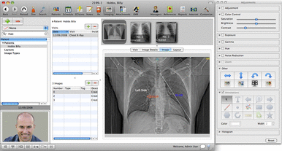
UI design principles
User familiarity
The interface should be based on user-oriented terms and concepts rather than computer concepts

Slide 20
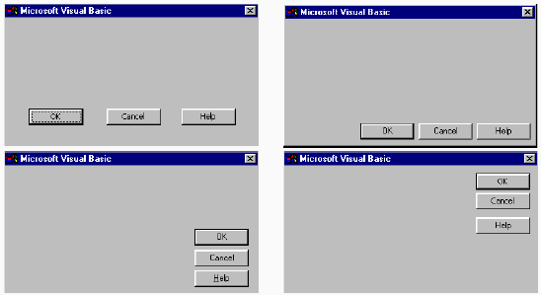
UI design principles
Consistency
The system should display an appropriate level of consistency
Commands and menus should have the same format, command punctuation should be similar, etc.

Slide 21
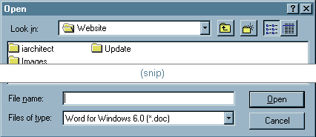
UI design principles
Minimal surprise
If a command operates in a known way, the user shall not diagnose abnormal behaviors

Slide 22
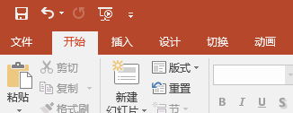
UI design principles
Recoverability
The system should provide some resilience to user errors and allow the user to recover from errors
This might include an undo facility, confirmation of destructive actions, 'soft' deletes, etc.

Slide 23
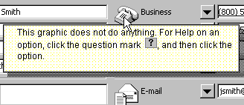
UI design principles
User guidance
Some user guidance such as help systems, on-line manuals, etc. should be supplied

Slide 24

UI design principles
User diversity
Interaction facilities for different types of user should be supported
E.g., some users have seeing difficulties and so larger text should be available

Slide 25
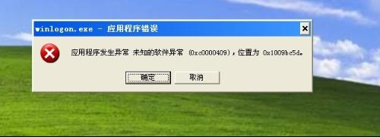
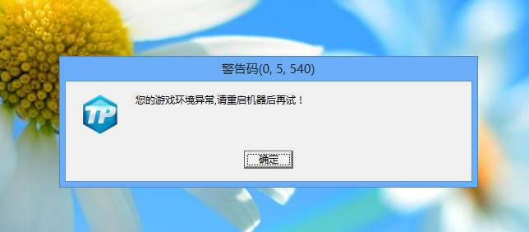
UI design principles
Meaningful feedback
Programmers often use UI to debug

Slide 26
Usability attributes
Learnability
How easy is it for users to accomplish basic tasks the first time they encounter the design?
Efficiency
Once users have learned the design, how quickly can they perform tasks?
Memorability
When users return to the design after a period of not using it, how easily can they reestablish proficiency?
Errors
How many errors do users make, how severe are these errors, and how easily can they recover from the errors?
Satisfaction
How pleasant is it to use the design?

Slide 27
Simple evaluation techniques
Questionnaires for user feedback
Video recording of system use and subsequent tape evaluation.
Instrumentation of code to collect information about facility use and user errors.
Analyze help desk logs
Analyze access logs for web apps

Slide 28

Internationalization
Why should a team want to internationalize / localize its app?
reach a wider audience
make more money
Is it worth it to localize?
May need to evaluate cost/benefit:
What fraction of our users speak that language?
Development effort
Open-source software is often translated for free by community
Maybe you can post your code and let them do it ...

Slide 29
Locales
locale: A geographic/cultural location targeted for localization.
A locale consists of:
a language (e.g. English)
often expressed as an ISO-639-1 code: de, en, fr, ja
Why isn't it enough to specify just the language?
Different locations may use different conventions, spelling, etc.
"color" (US) vs. "colour" (UK)
"localize" (US) vs. "localise" (UK)
Other differences (dates, currency, numbers, time zone, etc.)

Slide 30
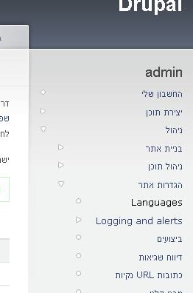
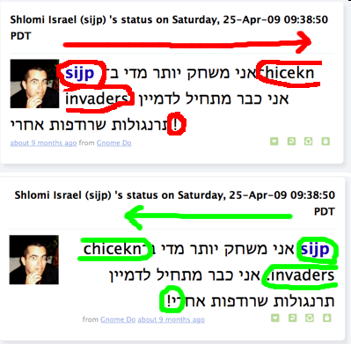
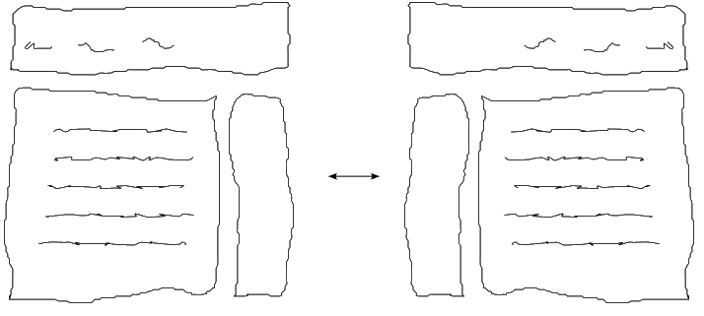
Right-to-Left (RTL)
Some languages begin lines on the right side and go left
Arabic, Farsi/Persian, Hebrew, Kurdish, Punjabi, Somali, ...
Often handled by supplying separate .css files for RTL locales
Can lead to lots of subtle UI bugs based on coders' LTR assumptions

Slide 31
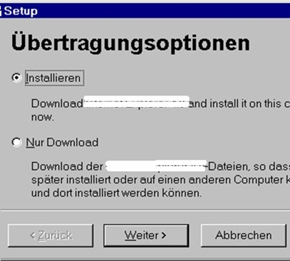
Localization gotchas
Some languages (e.g. German) use long words
buttons/labels get too wide for space provided
Some Unicode characters look like ASCII ones
U+00A0 "non-breaking space" character
"-" vs. U+2014 "em-dash" —, U+2013 "en-dash" –
Some fonts don't have all characters
but a smart OS can use font substitution
Regular expressions / text searches may not match i18n input
ex. \w "word boundary" doesn't match Unicode word delimiters
Web server might return text that has not been localized (Ajax)

Slide 32
Differences between locales
language English vs. German
spelling "color" vs. "colour"
slang "line" vs. "queue"
number formatting
telephone number format (206) 949-0504 vs. +1.206.949.0504
decimal separator, digit groups
currency units/formatting $123.45 vs. 123,45€
date formatting 3/14/10 vs. 2010/Mar/14
keyboard shortcuts
text direction hello vs. שָׁלוֹם
left-to-right ("LTR") vs. right-to-left ("RTL"), AKA "bidi" issues
multimedia: spoken audio; video subtitles

Slide 33
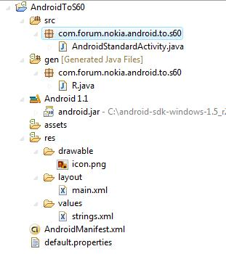
Android localization
Android apps store resources in res/ folder
text strings go in strings.xml files:
res/values/strings.xml (defaults)
res/values-en/strings.xml (English)
res/values-fr/strings.xml (French)
Testing locales:
(on a real Android device) Home → Menu → Settings →
Locale & text → Select locale

Slide 34
strings.xml example
<!-- res/values/strings.xml -->
<?xml version="1.0" encoding="utf-8"?>
<resources>
<string name="greeting">Hello!</string>
<string name="login">User %1 logged in.</string>
</resources>
<!-- layout XML file that uses string in View -->
<TextView
android:layout_width="fill_parent"
android:layout_height="wrap_content"
android:text="@string/greeting" />
// in-app Java code that grabs a resource string
Resources res = getResources();
String greet = res.getString(R.string.greeting);
String msg = String.format(
res.getString(R.string.login), userName);

Slide 35


Other resources
Images are in res/drawable
res/drawable/company-logo.png (English)
res/drawable-fr/company-logo.png (French)
<!-- layout XML file that uses image in View -->
<ImageView
android:layout_height="wrap_content"
android:layout_width="wrap_content"
android:src="@drawable/company-logo" />
Layouts are in res/layout
Menus are in res/menu
Colors are in res/values/colors.xml

Slide 36
Formatting dates
Differences in how to display dates across locales:
names of the months/days (Monday vs. Lundi)
ordering of days (what day does a week start/end)
relative order of y/m/d (3/14/2010 vs. 2010/Mar/14)
time zone (usually offset from UTC/GMT)
12 vs. 24 hour time (5:00 PM vs. 17:00)
java.text.DateFormat formats dates
styles: DateFormat.DEFAULT, FULL, LONG, MEDIUM, SHORT
DateFormat fmt = DateFormat.getDateTimeInstance(
DateFormat.LONG, DateFormat.SHORT, locale);
String s = fmt.format(new Date());
Date d = fmt.parse(dateText.trim()); // parse a date

Slide 37
This class
UI design
Principle
Process
Evaluation
Internationalization
Language
Locale

Slide 38
UI design principles
User familiarity
The interface should be based on user-oriented terms and concepts rather than computer concepts

Slide 39
Usability attributes
Learnability
How easy is it for users to accomplish basic tasks the first time they encounter the design?
Efficiency
Once users have learned the design, how quickly can they perform tasks?
Memorability
When users return to the design after a period of not using it, how easily can they reestablish proficiency?
Errors
How many errors do users make, how severe are these errors, and how easily can they recover from the errors?
Satisfaction
How pleasant is it to use the design?

Slide 40
Simple evaluation techniques
Questionnaires for user feedback
Video recording of system use and subsequent tape evaluation.
Instrumentation of code to collect information about facility use and user errors.
Analyze help desk logs
Analyze access logs for web apps

Slide 41
Differences between locales
language English vs. German
spelling "color" vs. "colour"
slang "line" vs. "queue"
number formatting
telephone number format (206) 949-0504 vs. +1.206.949.0504
decimal separator, digit groups
currency units/formatting $123.45 vs. 123,45€
date formatting 3/14/10 vs. 2010/Mar/14
keyboard shortcuts
text direction hello vs. שָׁלוֹם
left-to-right ("LTR") vs. right-to-left ("RTL"), AKA "bidi" issues
multimedia: spoken audio; video subtitles

